Slide 1
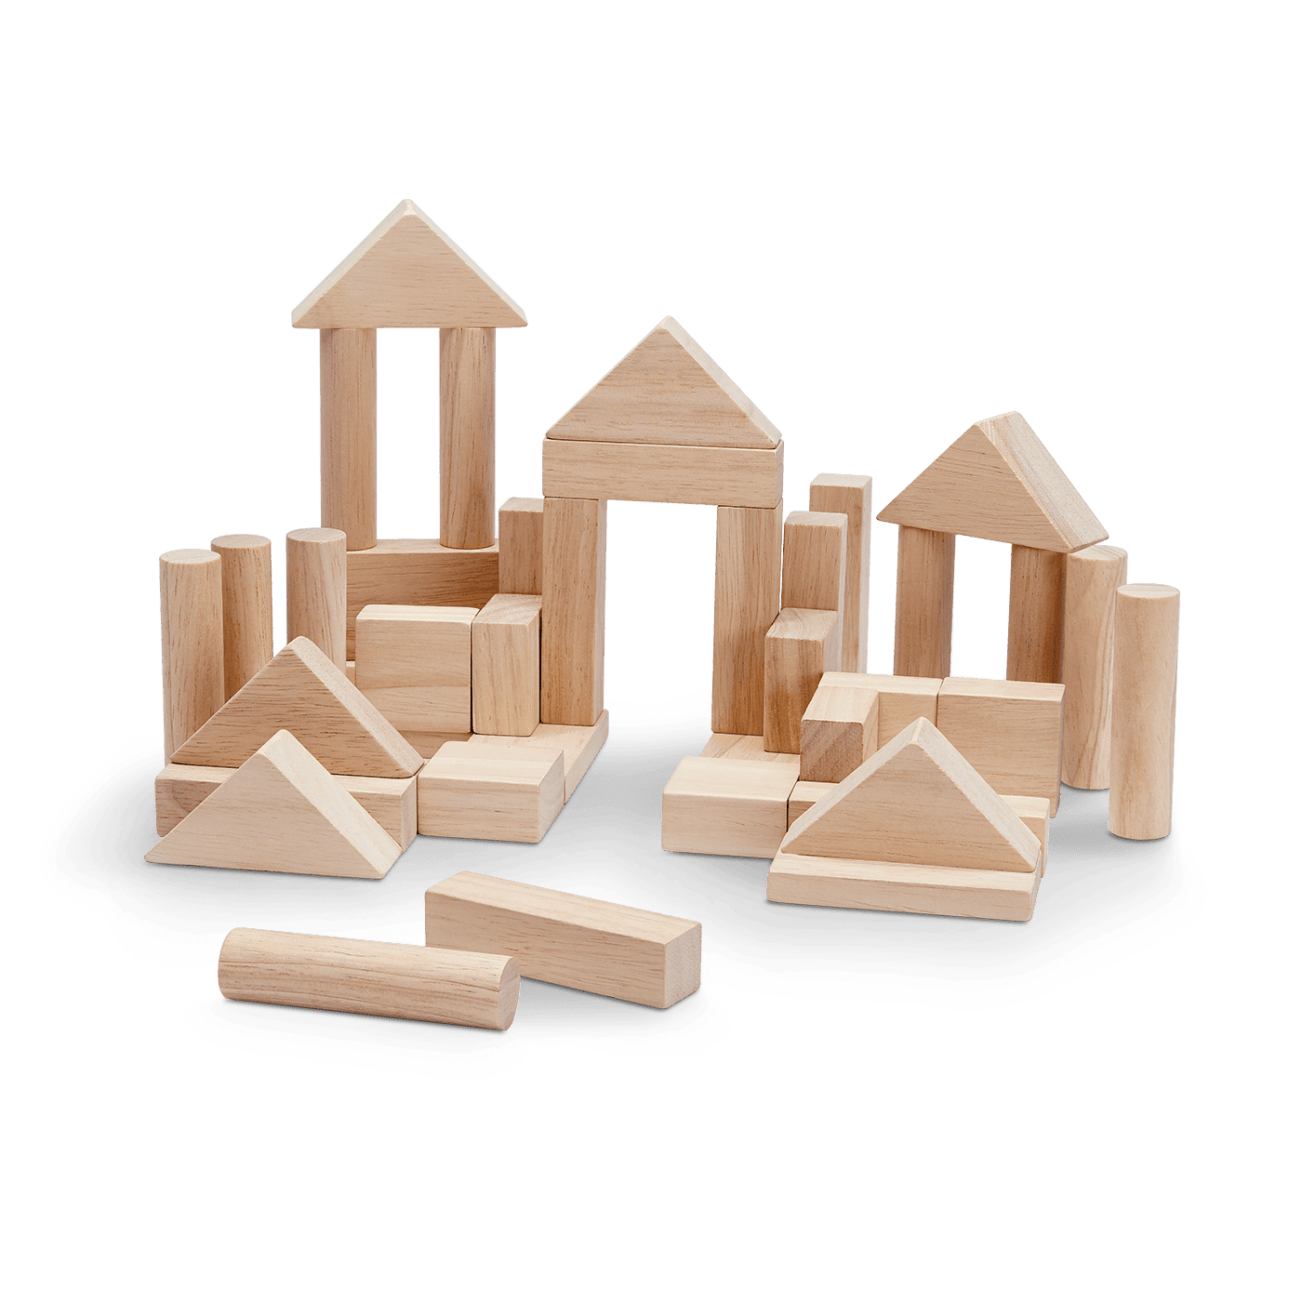
Correct Code by Construction
Paul Cadman
∧
Walter Schulze
Notes:
@Paul: [starts building]
@Walter: [starts setting up laptop]
What are you doing over there
@Paul: I am constructing
Constructing something
I don’t know what
What do you care
@Walter: Well we are supposed to do this presentation
I mean this is pretty awkward
Is it at least correctly constructed
@Paul:
This is a strong and stable construction.
There are no defects here at all
@Walter:
I assume if something is stable, it should at least be able to handle a little nudge
[Take out hammer, go in hard, but then only nudge it to make it fall over]
Hmmm doesn’t seem to stable to me
@Paul
Look who is talking, you are a programmer
The stuff you build is full of defects and falls over all the time
[Next slide]

Slide 2
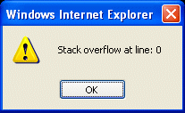
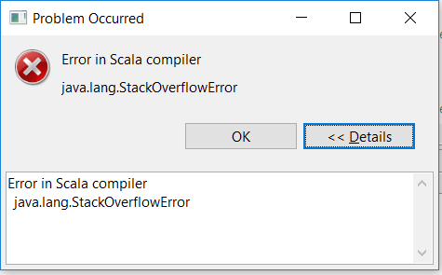
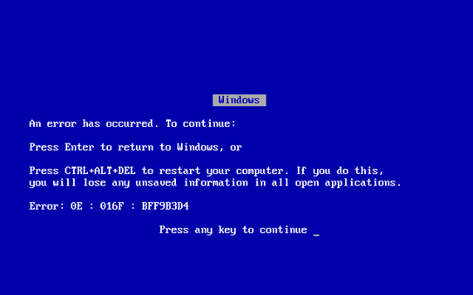

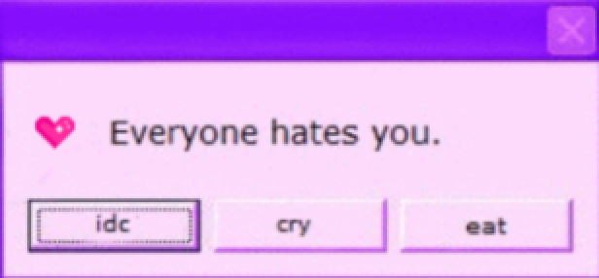
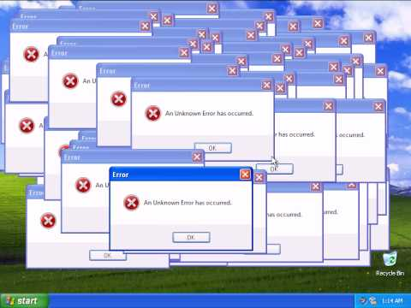
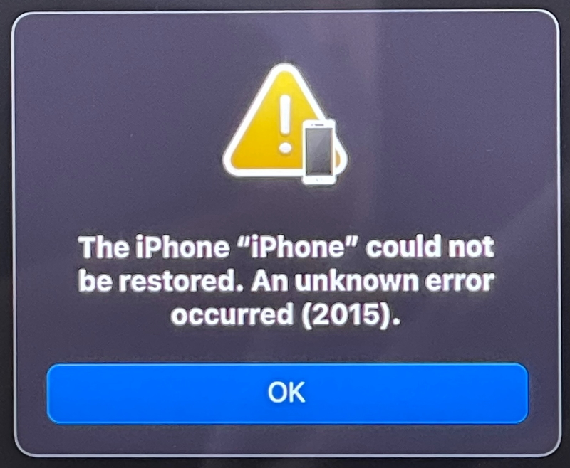
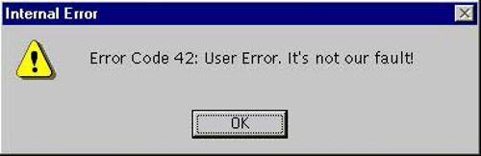
Notes:
References for ideas:
https://www.computerworld.com/article/3412197/top-software-failures-in-recent-history.html
https://www.testdevlab.com/blog/2021/12/27/10-biggest-software-bugs-and-tech-fails-of-2021/

Slide 3


Notes:
@Paul
Reference: https://www.emergingtechbrew.com/stories/2020/11/30/amazon-web-services-outage-takes-chunk-internet

Slide 4

Self-driving Cars
Notes:
@Paul
Reference: https://www.ft.com/content/89692fee-1181-11e7-80f4-13e067d5072c

Slide 5

Boeing found another software bug on the 737 Max
Notes:
@Paul
Reference: https://en.wikipedia.org/wiki/Boeing_737_MAX_groundings

Slide 6
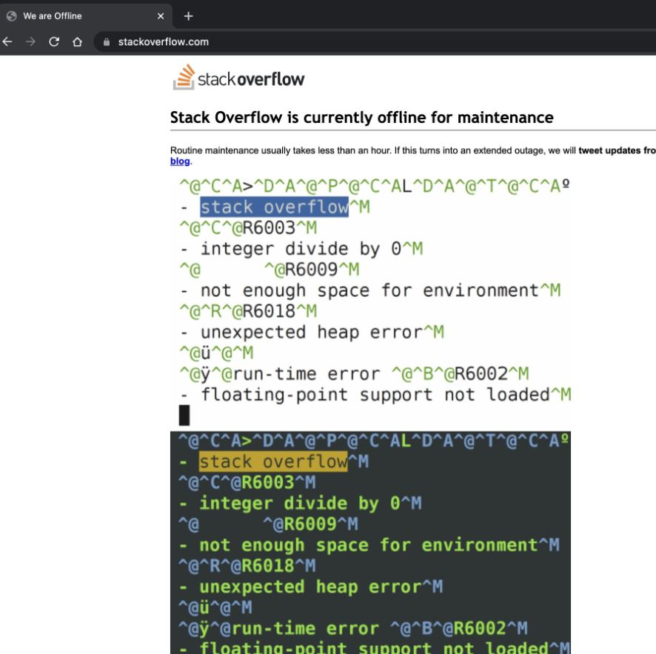
Where to ask for help when
Stack Overflow
is down
Notes:
@Paul

Slide 7
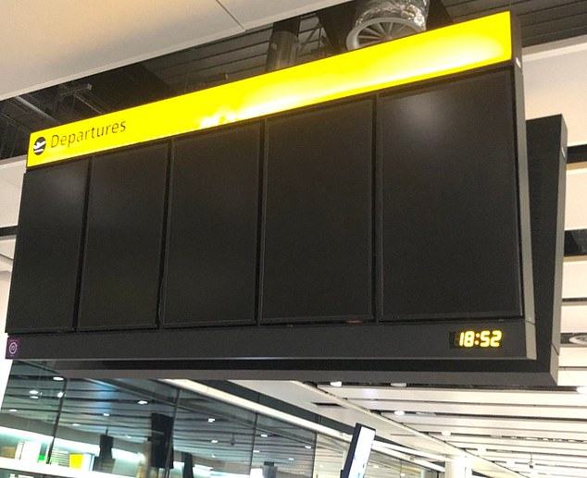
100 Flights at Heathrow disrupted by bug in departure boards and check-in systems
Notes:
@Paul
Reference: https://www.computerworld.com/article/3412197/top-software-failures-in-recent-history.html#slide1

Slide 8
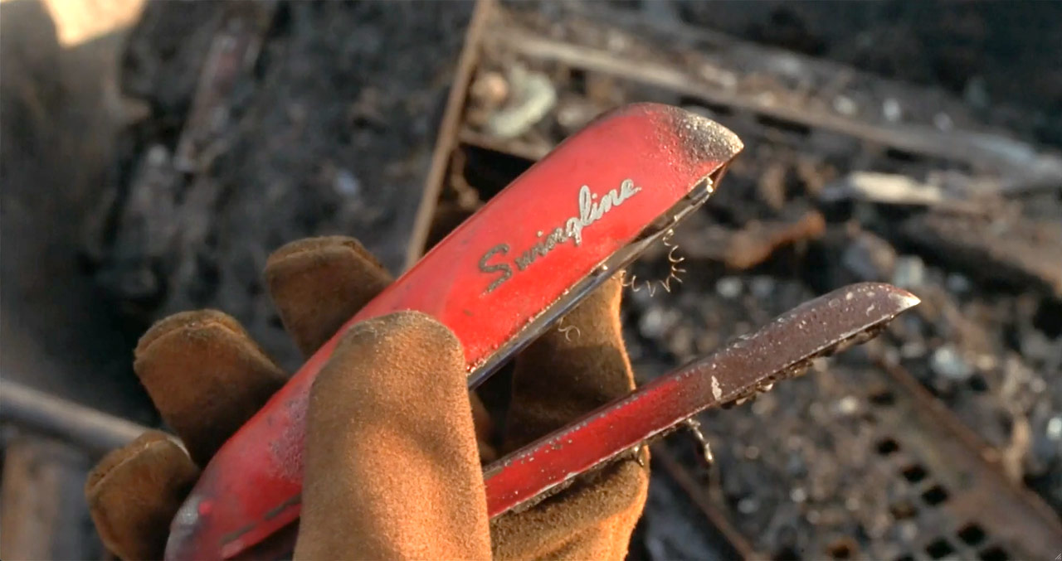
1999: INITECH Fire and Theft
Notes:
@Walter
Yeah that is fair, people call us developers, architects or even worse engineers
As if we are doing calculations about structural integrity before we start building

Slide 9

Software Toddlers
Notes:
@Walter
I mean we are just playing with wooden blocks and suddenly someone walks in the room, very impressed and asks us if our miniature village can scale to real humans living in it.
And we like an enthusiastic 5 year old say yes. We want humans living in wood block villages without any nails or cement. We think this is realistic
[click]
They should call us Software toddlers not software engineers

Slide 10






Formal Verification in Industry
Product | Verified
WebAssembly | Spec
Chrome and Firefox | Important parts of TLS
Zilliqa | Smart Contract Language
Tezos | Protocol
Hedera | Proof of Stake Hashgraph
Cosette | SQL Optimizer
Rustbelt | Safe parts of "unsafe" Rust code
Notes:
@Paul Probably a good idea to verify the most important parts of your code
Like all of the these products have done
They use mathematical proofs that are verified by the computer, also called Proof Assistants
Maybe we can use this talk to explore this formal verification
Since you have destroyed my beautiful construction
@Walter: Sounds good to me, since we already have the slides prepared for it, we might as well
Now just to warn you, you might not understand everything and that is okay.
The main take away from this talk is that there are tools to do more rigorous programming with and to give you a little demo of what it is like using them.
@Paul
So far formal verification has been used to find bugs in the web assembly spec
Firefox and chrome reimplemented the important parts of TLS using these tools
It is also been used to verify smart contract languages and crypto protocols
These are just some examples of it being used and there are many more examples including finding optimizations of code.
References:
- Correct-by-Construction Cryptographic Arithmetic in Coq - Adam Chlipala, MIT CSAIL Lambda Days February 2021
- Scilla: https://github.com/Zilliqa/scilla-docs/blob/8bc995969d6581364a0788c0c06c6a97a05975b9/docs/source/index.rst
- Tezos: https://nomadic-labs.gitlab.io/coq-tezos-of-ocaml/
- Hedera Checked their AbFT proof

Slide 11
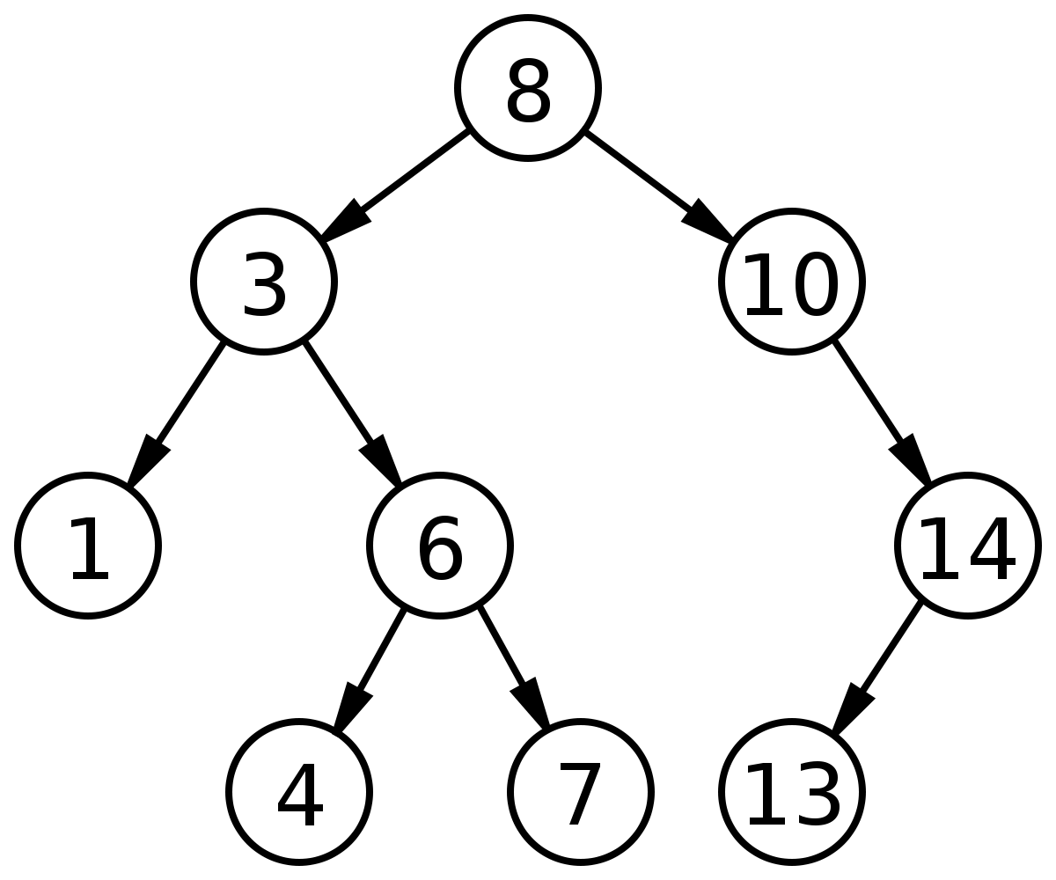
Binary Search Tree
Left is
Less
Right is moRe
Notes:
@Walter
Okay Paul, so let me see how we would verify a Binary Search Tree
I don’t think that is too much to ask, since it is a popular topic of coding interviews
In a Binary Search Tree
The values are stored in the tree in such a way that all left children are less than their parents and ancestors
And all right children are more than their parents and ancestors
This way it is possible to search through the tree in log n time and insert in the tree in log n time as well
Which is an efficient solution for some use cases.

Slide 12
Kotlin: Tree
sealed class Tree {
object Nil : Tree()
data class Node(
val lefty: Tree,
val value: Int,
val righty: Tree
) : Tree()
}
Notes:
@Walter
So this is how I would write a tree in Kotlin
It uses a sealed class
Which means it can be constructed in two ways
One for a Nil tree and another for a Tree with a value.

Slide 13
Kotlin: Contains
fun Tree.contains(x: Int): Boolean =
when (this) {
Tree.Nil -> false
is Tree.Node ->
if (x < value) {
lefty.contains(x)
} else if (value < x) {
righty.contains(x)
} else {
x == value
}
}
Notes:
@Walter
And this is how I would write the contains function for a binary search tree
I do some pattern matching and then use the fact that the tree is a binary search tree
Recursing down the left or right, whichever is appropriate
@Paul So how would you make sure this is correct?

Slide 14
Kotlin: Unit Test
@Test
fun `tree with a single node 1 contains 1`() {
val tree = Tree.Node(Tree.Nil, 1, Tree.Nil)
assertThat(
tree.contains(1)
).isTrue()
}
Notes:
@Walter
Well I would mostly use unit tests

Slide 15
Kotlin: Property Test
@Property
fun `inserted value is contained in tree`(
@ForAll("trees") tree: Tree,
@ForAll ivalue: Int
) {
assertThat(
tree.insert(ivalue)
.contains(ivalue)
).isTrue()
}
Notes:
@Walter
And if I was lazy and didn’t want to think of all cases, I would use a property based test.
This randomly generates the inputs and makes sure that whatever I insert into the tree is contained in it after I inserted it.
@Paul
Well these properties, look mathematical and are actually something we could prove
Which means that even the recursive edge cases won’t be missed and the tests won’t take forever to run and clog up your CI, since it will be checked at compile time

Slide 16




Tool: (x < y = true) → (x ≤ y = true) /\ (x == y = false)
Leq: (x ≤ y = true)
Tool H: (x ≤ y = true) /\ (x == y = false)
Neq: (x == y = false)
H: (x < y = true)
y: nat
forall (x: nat) (y: nat),
(x < y = true) → (x ≤ y = true).
x: nat
(x < y = true) → (x ≤ y = true).
(x ≤ y = true).
forall (y: nat),
(x < y = true) → (x ≤ y = true).
Qed.
Notes:
@Paul: Let’s start with a basic proof of comparisons, which we’ll also need to use later.
We want to prove that for any two numbers x and y, if x < y then x is also <= y.
@Walter: Can I be your assistant
@Paul: Yeah you can be my … proof assistant
@Walter: Great, I know how to use a hammer
[hammer from toolbelt].
I have heard that if you have a hammer you apply it to all problems.
So how about we start with nailing somethings on the wall.
@Paul: So you mean nailing x, y and the hypothesis to the wall, or rather above the line.
[Click]
Now we only need to prove the comparison below the line.
Everything above the line is now a given or assumption.
@Paul: Oh Walter what else have you got in your toolbox
[Click]
@Walter: Well I have this thing, it is a Lemma that says that
[Click]
If something is smaller than x, then that something is smaller or equal to x and not equal to x.
@Paul: Ah I can use that.
I can apply it, like I would apply a function.
Tool is a function and H is the first parameter.
If I apply it [click] I get
y is smaller or equal to x and y is not equal to x.
[Look over to Walter]
@Walter I don’t seem to have any more tools
@Paul: well you are a pathetic excuse for an assistant.
I guess I’ll call my friend wreck it Ralph.
He is also in construction.
I think you can break apart Tool H
[Click]
@Paul: Thank you Ralph
I see now we have exactly what we want above the line
[Click]
So we have constructed what we want
And delivered our goal
So the proof is complete
[click] Qed
Which just means that the proof is complete

Slide 17
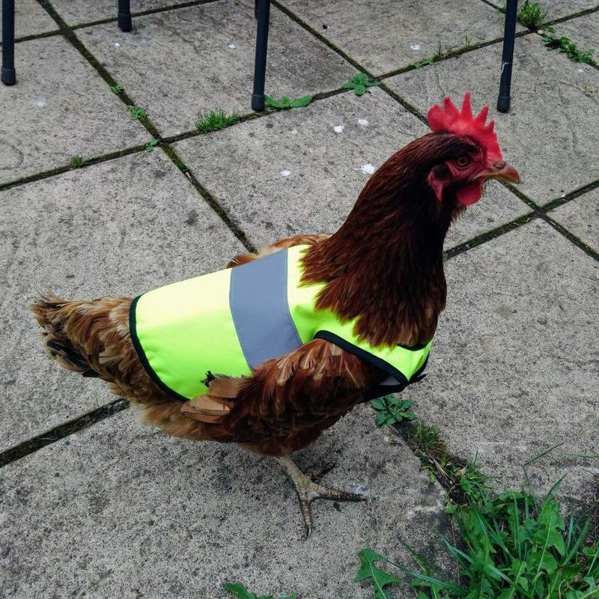
Coq Proof Assistant
Notes:
@Paul
I think I need more help - I need another assisant.
Since you are not a great proof assistant.
I found a better proof assistant, called the Coq proof assistant

Slide 18
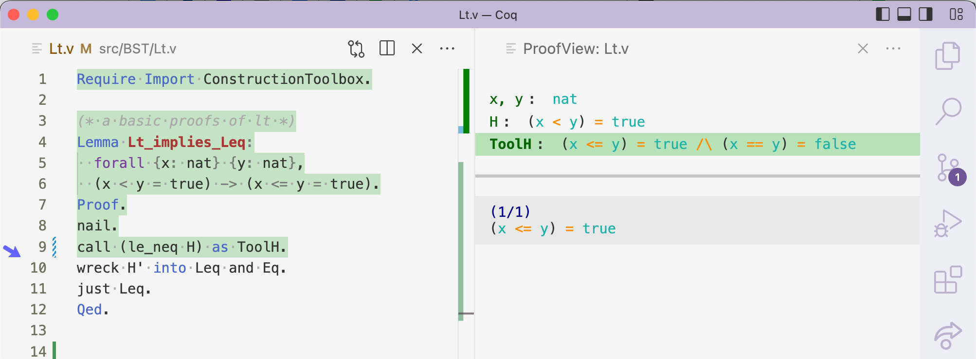
Your code / proof
Proof Assistant
Hypotheses
checked
Goal
unchecked
Notes:
@Paul
I can use it in VS Code.
This allows you to type the tools we want to use on the left and the proof assistant will provide hints on the right.
The hints include the hypotheses available to us to use above the line
And the goal we need to prove below the line.
On the left we can type our proof and evaluate or check it as we go.
The right will reflect the current state of the proof and include all the hints we have accumulated in the green parts of the code.
We can then step up and down to change the hints provided on the right by the assistant.

Slide 19
Prove using Coq
(x < y) = true -> (y < x) = false.
Notes:
@Paul
let’s try to prove this in Coq
We want to prove that if x is smaller y then y is not smaller than x.
This proof will use our previous proof and we are going to need it later.
[VS Code Lt.v]
@Walter can I still be your proof assistant
@Paul, well uh … now that I have a real proof assistant
I don’t really need you anymore
It doesn’t just suggest tools, it also automatically checks the correctness of my proofs

Slide 20

Notes:
@Walter
Okay okay uhm
Maybe I can be the assistant to the prover
@Paul it is not a real title, but if it makes you happy
@Walter thank you so much you won’t regret this

Slide 21
Coq
Kotlin
Inductive tree: Type :=
| Nil
| Node
(lefty: tree)
(value: nat)
(righty: tree).
sealed class Tree {
object Nil : Tree() {}
data class Node(
val lefty: Tree = Nil,
val value: Int,
val righty: Tree = Nil
) : Tree()
}
Notes:
@Walter
We can also write code in Coq, not just proofs.
Here we have the tree I wrote in Kotlin
And on the left is the same tree defined in Coq
It also has two constructors
One for the Nil tree
And one for a Node with a value
This an inductive type because later we’ll be able to do mathematical induction on it

Slide 22
Coq
Kotlin
Fixpoint contains
(x: nat) (t: tree): bool :=
match t with
| Nil => false
| Node lefty value righty =>
if x < value
then contains x lefty
else if value < x
then contains x righty
else x == y
end.
fun Tree.contains
(x: Int): Boolean =
when (this) {
Tree.Nil -> false
is Tree.Node ->
if (x < value) {
lefty.contains(x)
} else if (value < x) {
righty.contains(x)
} else {
x == value
}
}
Notes:
@Walter
I can write the Kotlin contains function in Coq too.
A function is called a Fixpoint, if it contains recursion.
The rest are simply syntactic differences between the two languages.
Like function application which is done with a space, instead of parentheses
It does a pattern match on the tree, t.
If the Tree is nil it returns false.
Otherwise it checks the value and continues the search on the appropriate branch.

Slide 23
Coq can Evaluate Code
Example example :=
Node Nil 1 Nil.
Theorem ExampleTreeContains1:
contains 1 example = true.
Notes:
@Paul maybe you want to try to proof something simple, Walter
Simple for your simple mind
@Walter
[VSCode BST1.v]

Slide 24
Coq proofs can be reused
Example example := Node Nil 1 Nil.
Theorem ExampleTreeContains1:
contains 1 example = true.
Theorem NestedTreeContains1:
forall (t: tree),
t = Node example 2 (Node Nil 3 Nil)
-> contains 1 t = true.
Notes:
@Paul
That is a really … good theorem, now let's ... "build" .. on that
[VSCode BST1.v]

Slide 25
insert Coq
Fixpoint insert (value: nat) (t : tree) : tree :=
match t with
| Nil => Node Nil value Nil
| Node l tvalue r =>
if value < tvalue
then Node (insert value l) tvalue r
else
if tvalue < value
then Node l tvalue (insert tvalue r)
else Node l value r
end.
Notes:
@Walter
Here is an insert function for the binary search tree.
Which you will need so that we can prove the property we had before.
It checks whether that the value being inserted is less or more than the current node's value and inserts it on the left or right appropriately.
Now I wonder if I made a mistake in this code.

Slide 26
Proving a Property
Theorem contains_insert_prop:
forall (t : tree) (value: nat),
contains value (insert value t) = true.
Notes:
@Paul
Let’s try to proof the property we had for our property based test.
[VSCode BST1.v]

Slide 27

Notes:
@Walter: I am a programmer, we Coq things up all the time

Slide 28
Coq found a bug
Fixpoint insert (value: nat) (t : tree) : tree :=
match t with
| Nil => Node Nil value Nil
| Node l tvalue r =>
if value < tvalue
then Node (insert value l) tvalue r
else
if tvalue < value
then Node l tvalue (insert tvalue r)
else Node l value r
end.
Notes:
@Walter
Ah I see I made a mistake where the yellow is highlighted
This is why you weren’t able to use IHrighty or the Induction hypotheses for the right insert, because inserting on the right side was coded incorrectly
The tvalue should have been a value.
Otherwise I am copying in the tvalue and not inserting value.
@Paul
It is pretty great that Coq found this bug.
Let's try that proof again, now with the fix.
[VSCode BST2.v]

Slide 29
Correct BST by Construction
Definition BSTinsert (ivalue : nat) (bst: BST): BST.
Definition BST := {t | isBST t}.
Inductive isBST : tree -> Prop :=
| Nil_isBST :
isBST Nil
| Node_isBST :
forall l x r,
isBST (Node l x r).
l << x ->
r >> x ->
isBST l ->
isBST r ->
Notes:
@Walter
Okay Paul that was a pretty neat proof.
But I have no type safety
I could have provided any tree to insert, not necessarily a binary search tree
Maybe you could do something even better and give me correct code by construction, instead of proving it after I wrote it.
I want to know that when I insert into a BST, I will get a BST back.
This is what the function here states.
But What is a BST
[Click]
A BST is a tree t, that also satisfies the isBST property
This is what these curly braces says.
Now we want to know what an isBST property is.
[click]
This states that
every Nil Tree is a BST
Otherwise all the left children have to be less than the root
And the right children have to be greater than the root
Also the left side has to be a BST
And the right as well
Then only the tree is considered to be a BST
This way it is impossible to construct a BST incorrectly.
This BST is correct by construction.
So you might be wondering where this
<< and >> symbols came from
Well Coq allows you to introduce notation, which we have done before the talk
So actually there are two functions used here, that do some recursion to check that all values are less or more, but it is out of scope for this talk.
But I just wanted you to know that this notation isn't some magic, there is just a function underneath.
@Paul let me try to write the BSTinsert function
[VSCOde – BST2.v]

Slide 30

Maths
Programmers
Maths is a tool for Programmers
Notes:
@Paul
Throughout my time studying maths I didn’t know the deep connection between maths and programming. I didn’t believe that proofs could have real-world industrial applications. How wrong I was! Maths is so useful in so many fields so we’d be missing out if we didn’t take advantage of this.

Slide 31
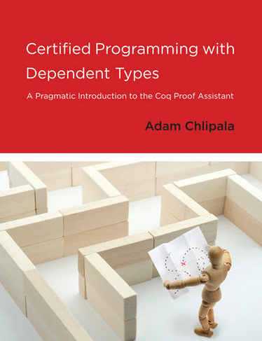
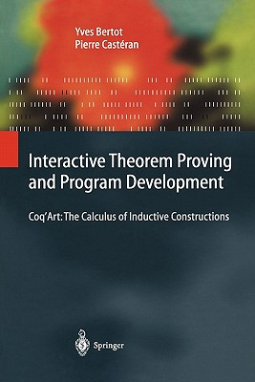

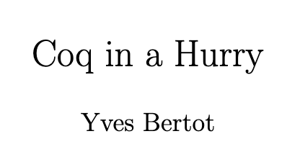
Getting Started
Coq Art Book:
Gentle Introduction to Coq
Intro to Dependent Types
QuickStart for Coq
Beginner to Intermediate
Coq
Notes:
@Paul
This is just a teaser for what is possible with Coq using a very basic example.
The learning curve is a bit steep learning curve and we would recommend finding a study group, like we did, to walk this path with you.
We really liked the book the Little Typer, that taught us all about dependent types, which is the powerful type system that Coq is built upon.
Then we found Coq in a Hurry was a great way to quickly start doing some Coq and get a feel for it.
CoqArt was great for explaining the basics
And the final book was great for finishing up our introduction to Coq

Slide 32



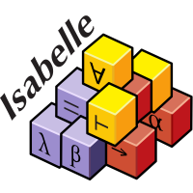


Other Languages
Notes:
@Walter
There actually exists several languages in which to do these proofs, not just Coq
TLA is used by Amazon
Idris, Agda are very popular
Micrsoft has Lean and F*
Isabelle was used to verify the web assembly spec

Slide 33
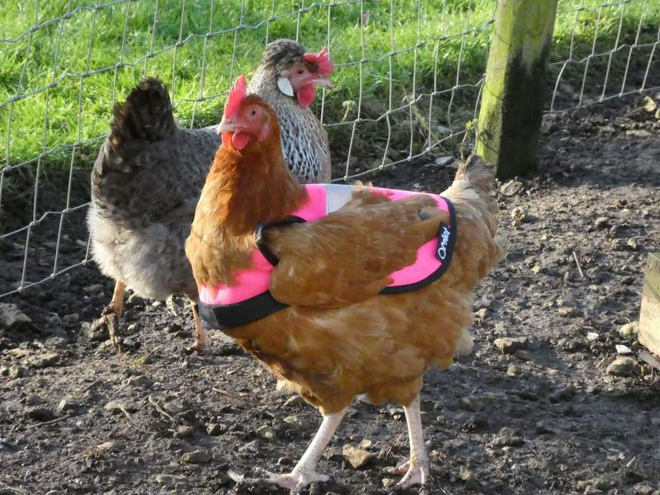
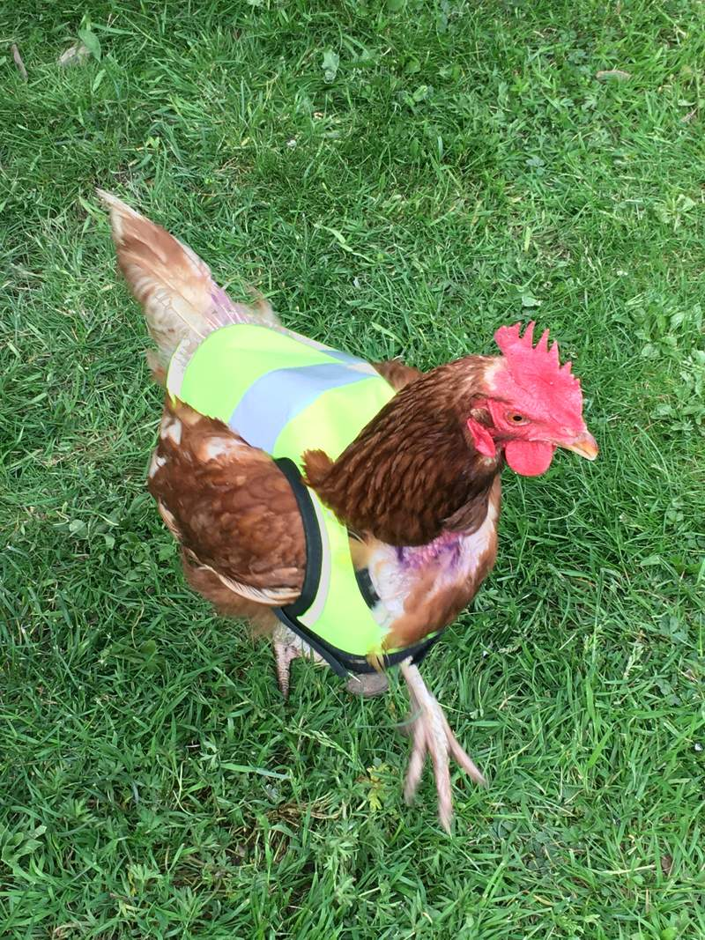
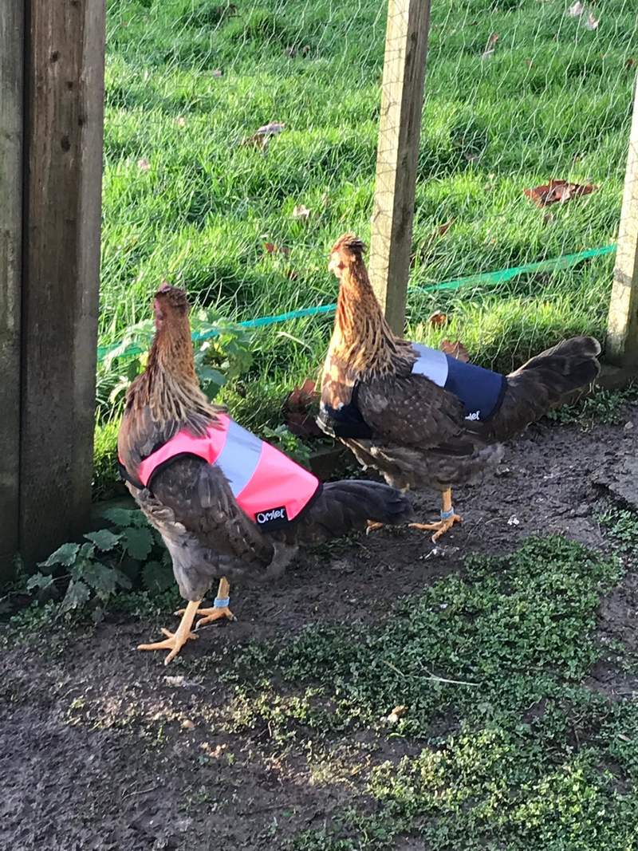
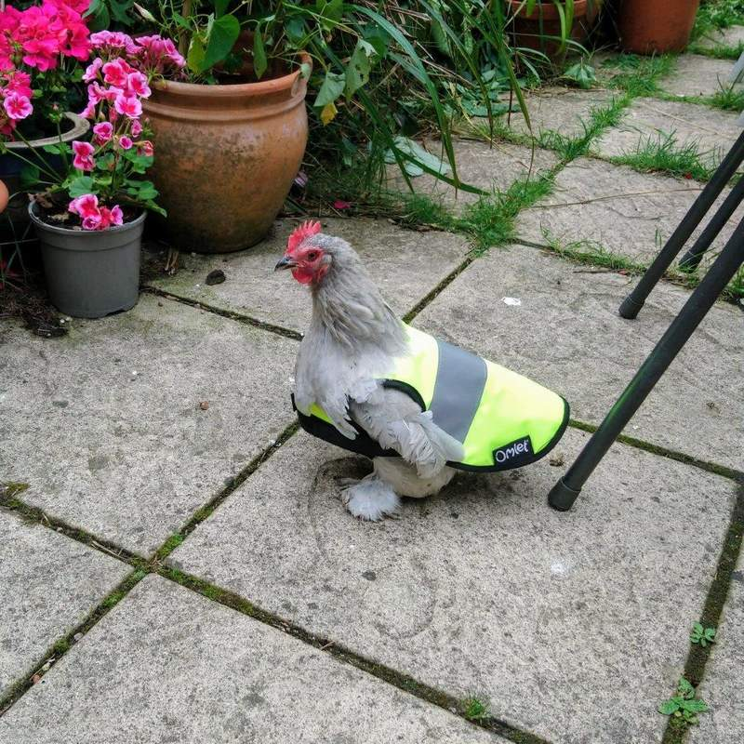
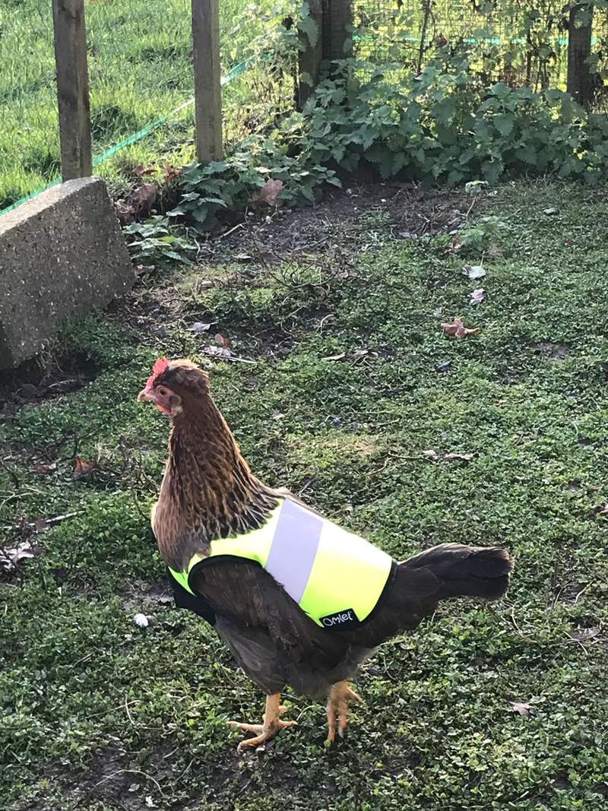
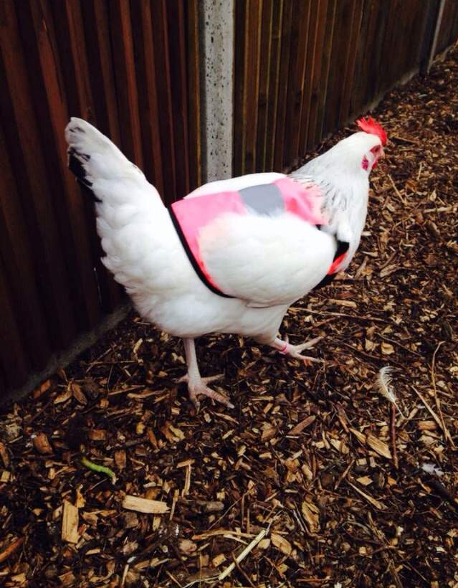
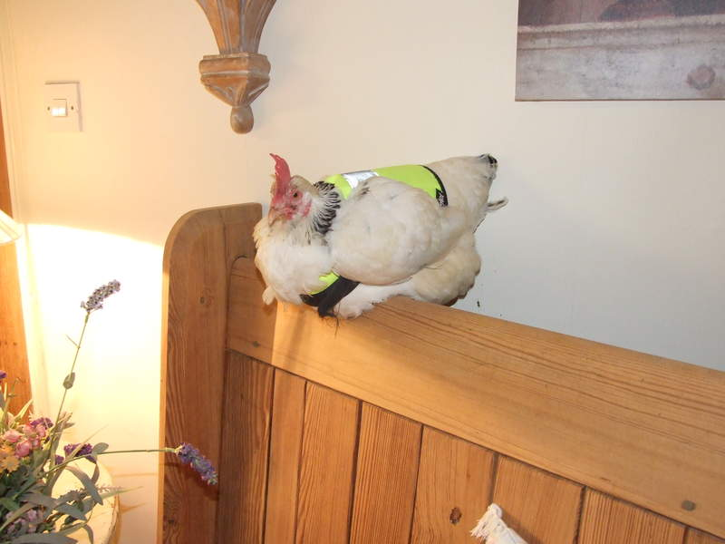
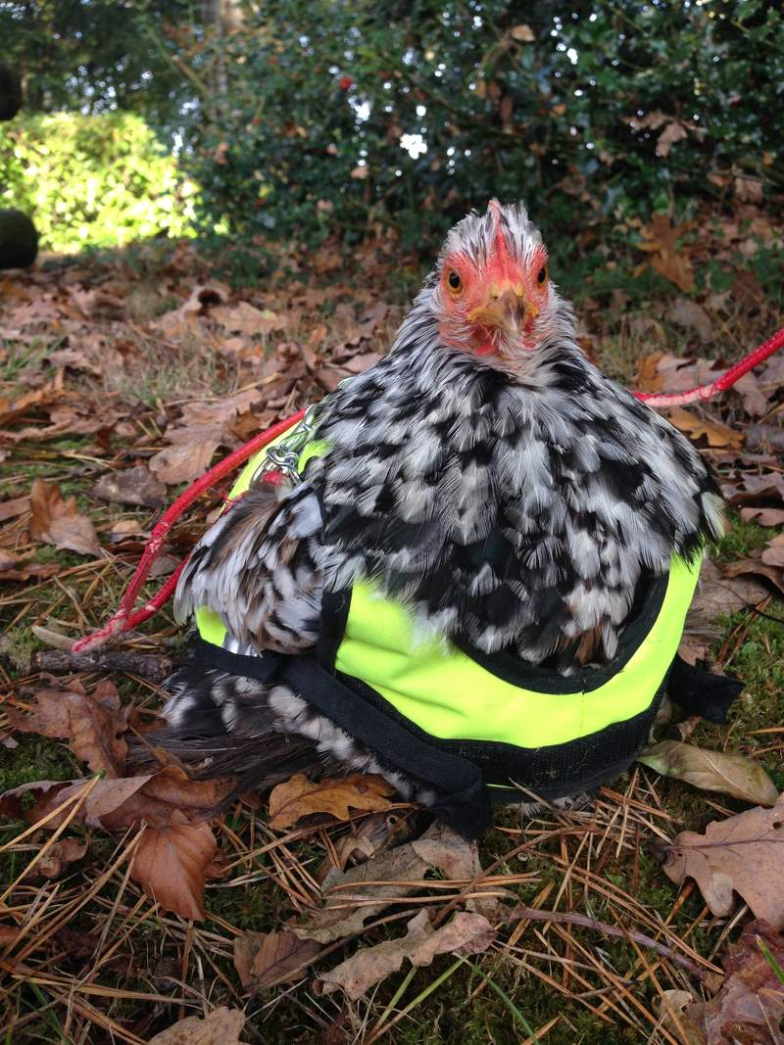
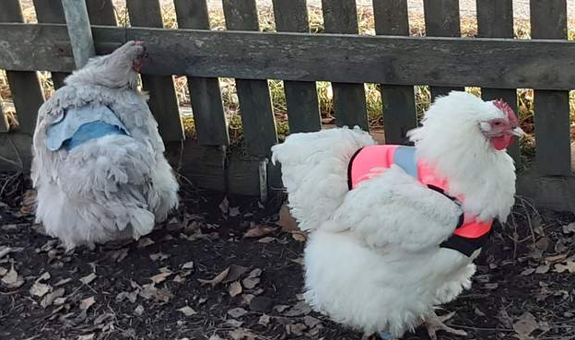
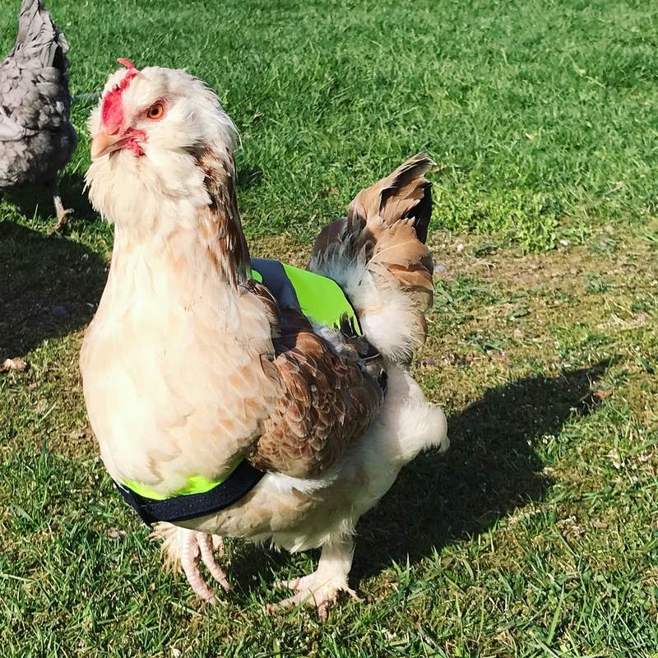
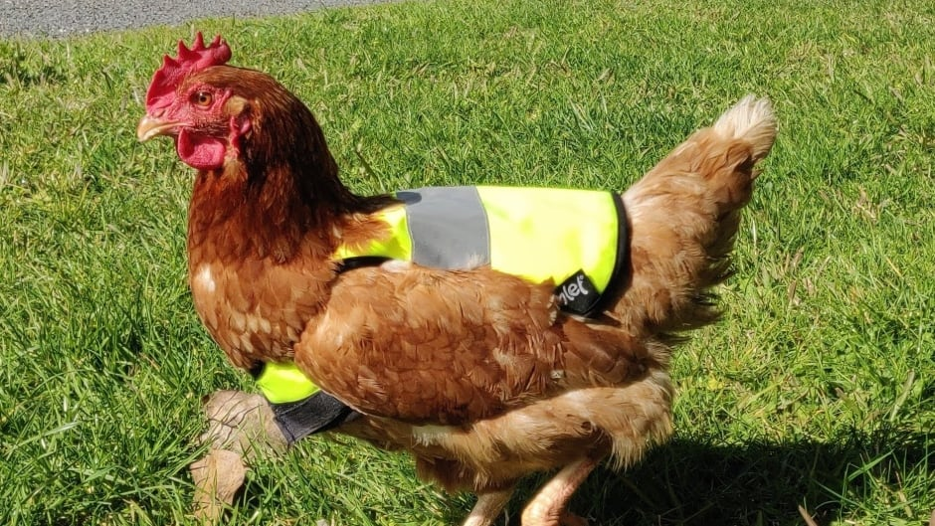
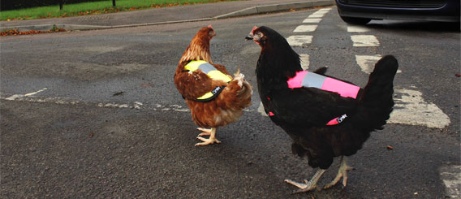
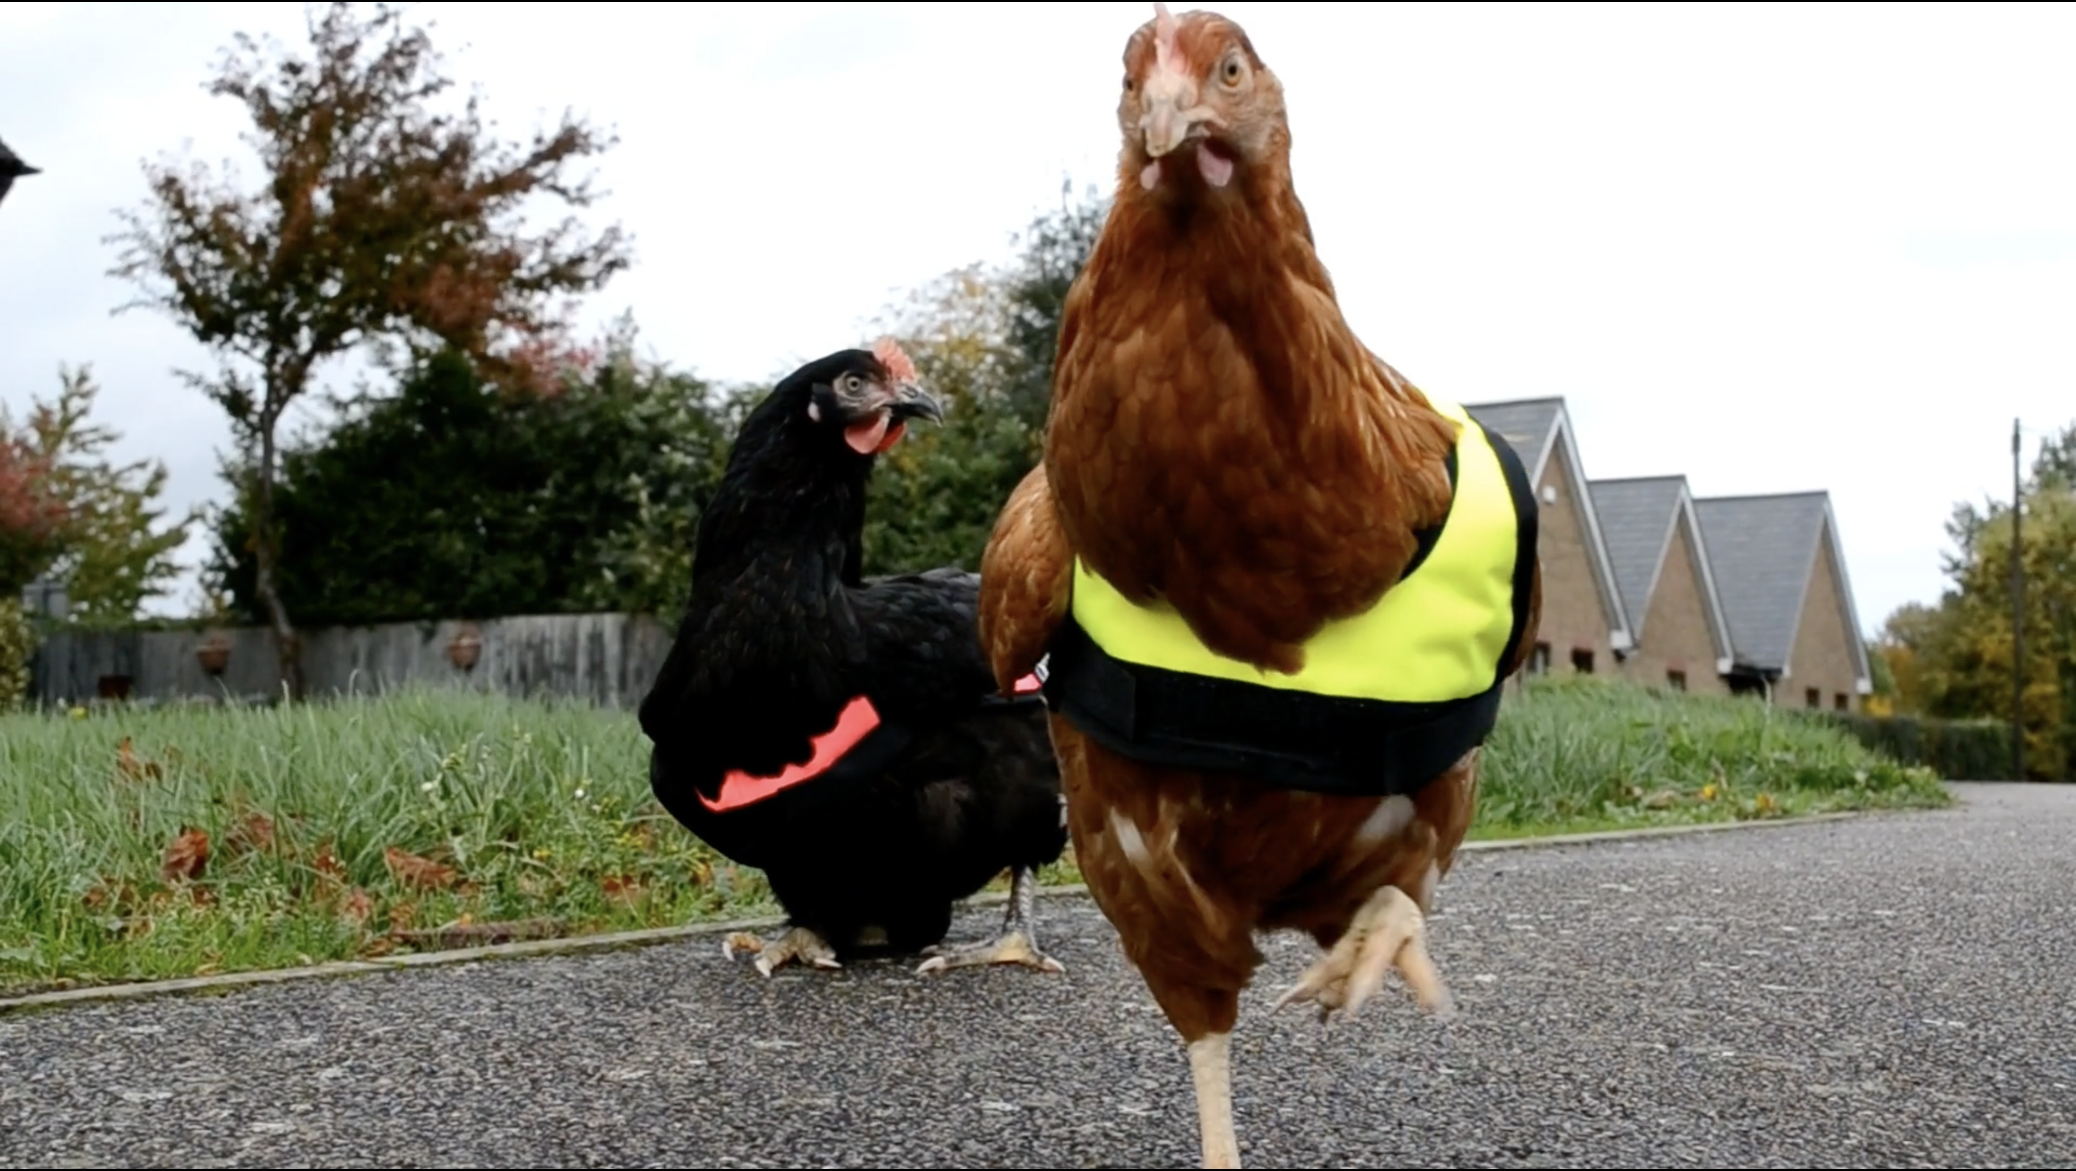
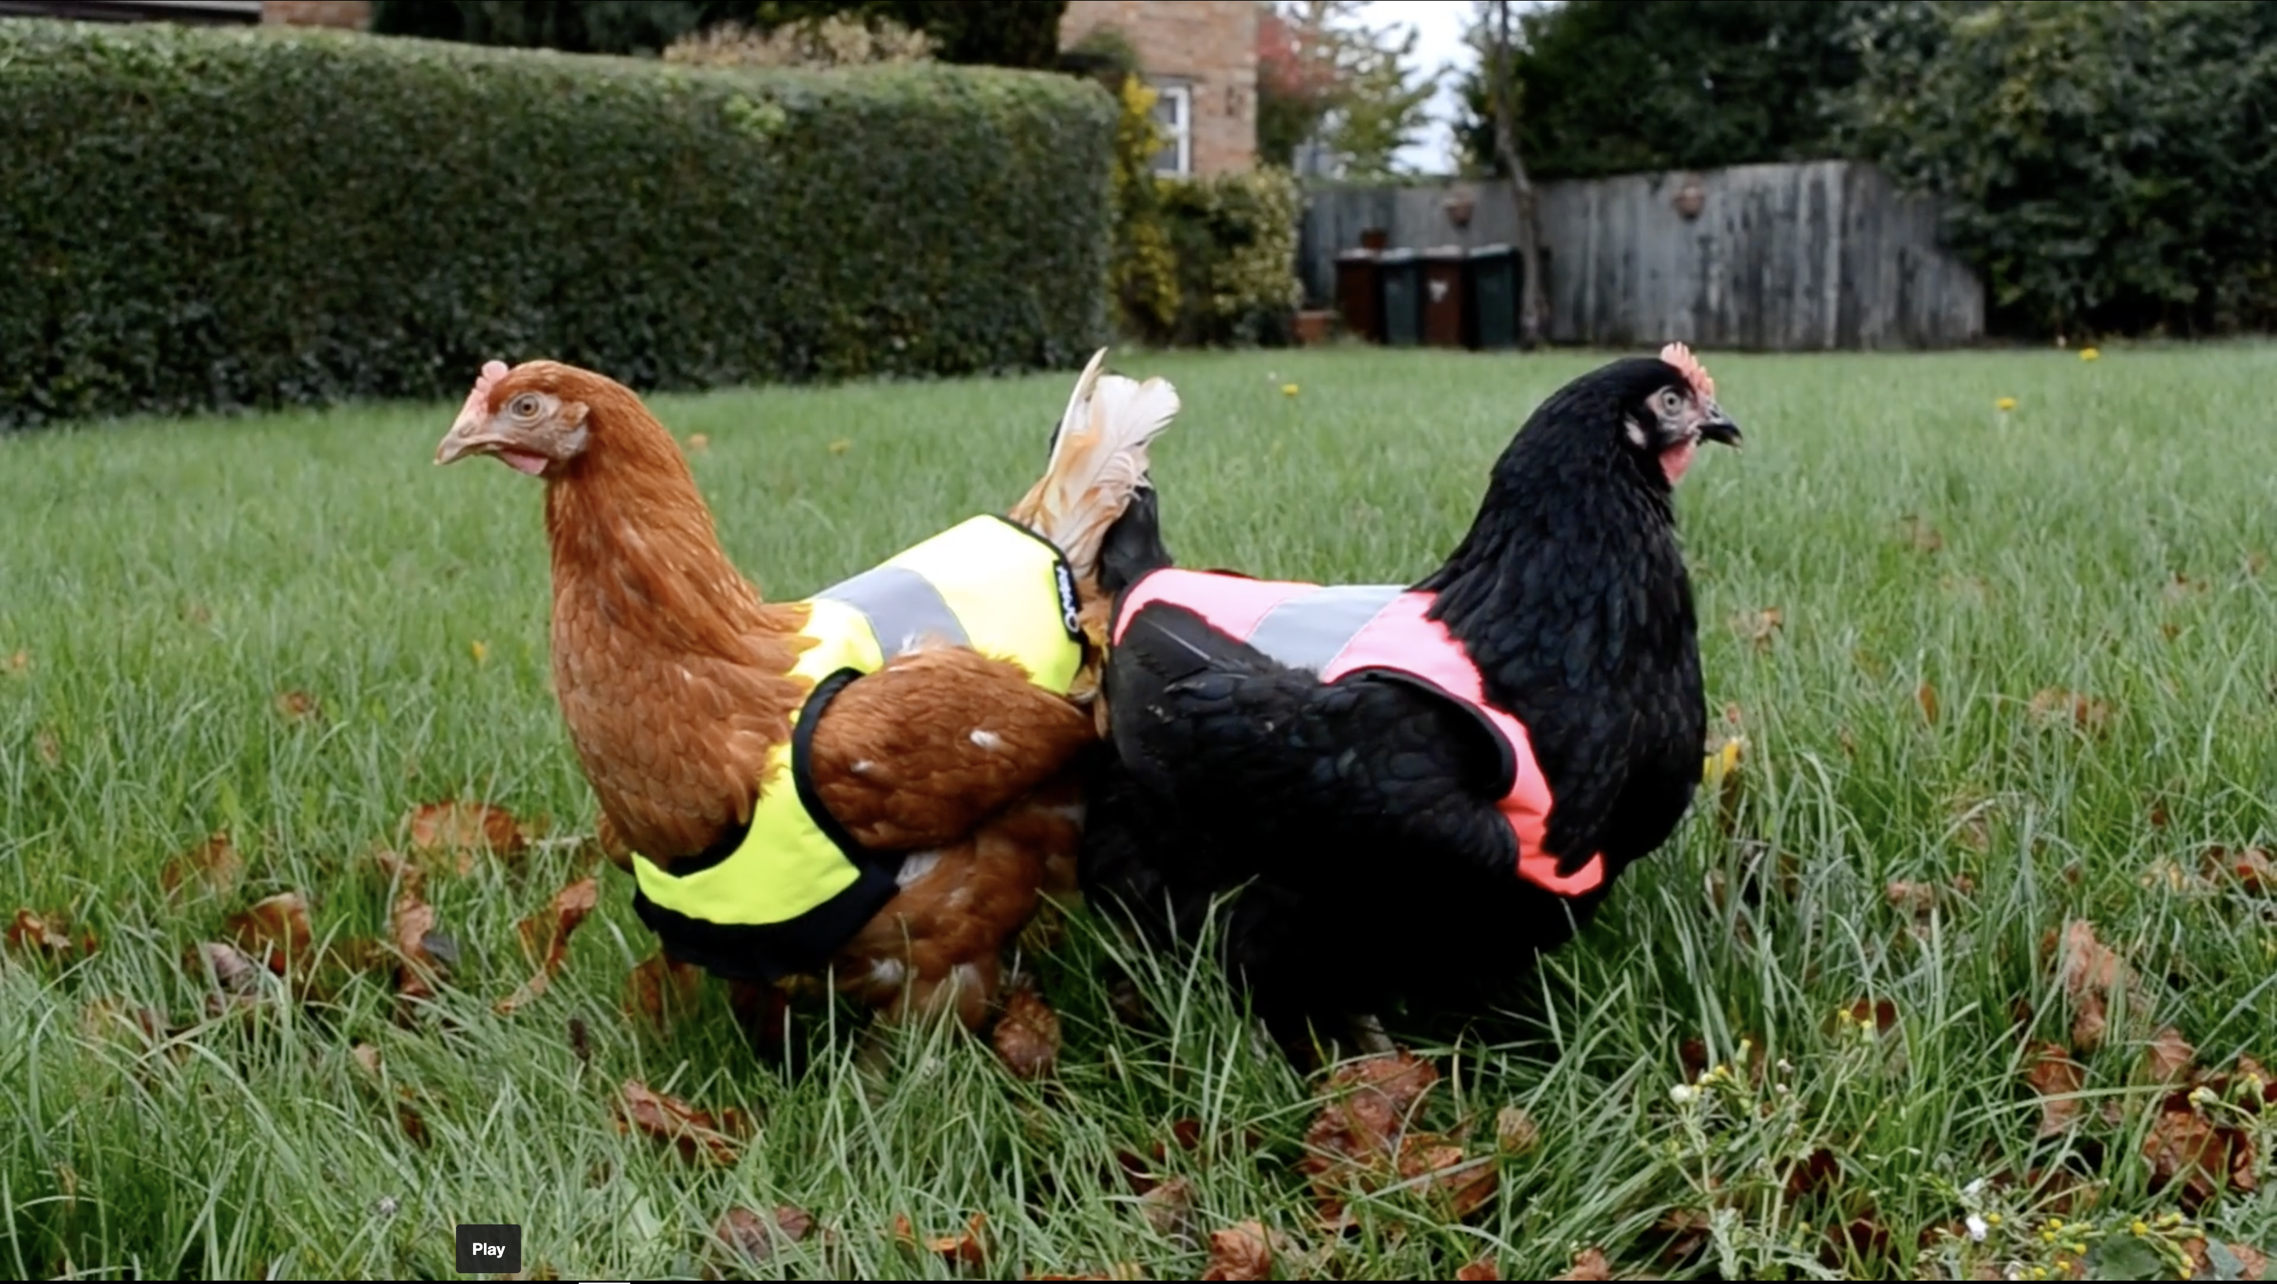



Q & A
/paulcadman
/in/paul-cadman/
/awalterschulze
/in/schulzewalter/
youtube.com/c/WalterSchulzeA
Code: https://github.com/awalterschulze/ccc-talk
Notes:
@Walter: So I am sure you have questions, although I haven't proved it yet
So let me use a tool and ask a question.
Do you have questions?
If you don't have questions you can look at some photos of chickens in high vis vests
Reference: https://www.omlet.co.uk/shop/chicken_keeping/high_vis_chicken_jacket/

